Slide 1
Energy Toolbase: ETB Developer User Guide
Step by Step Guide to Create a Proposal

Slide 2
Agenda
Create a Lead
Create Energy Use Profile
Create a Proposal
Proposal Configurations
Proposal Editor
Proposal Editor – General Information
Proposal Editor – Meter Portlet
Energy Use Profile & Utility Rates
PV System
Energy Storage
Transactions
Documents

Slide 3
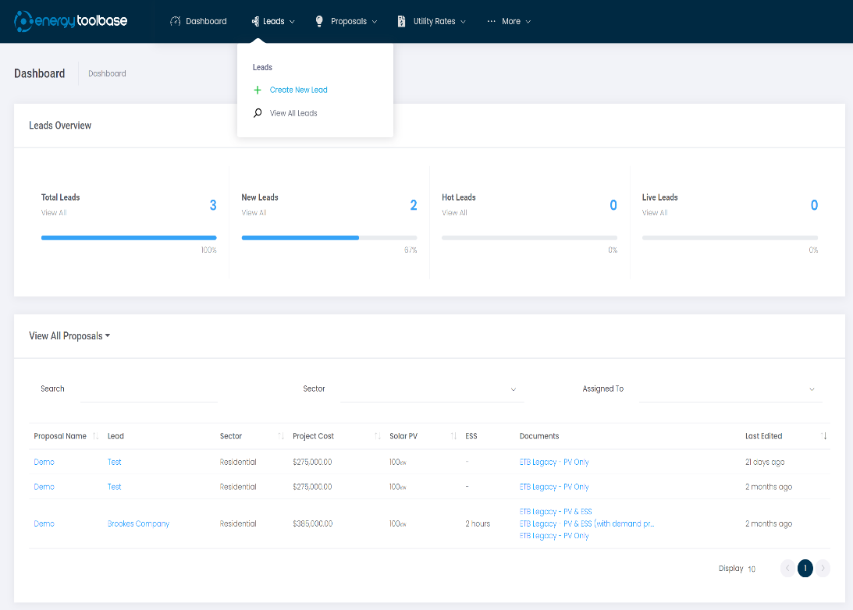
Create a new Lead
To create a lead, hover over ‘Leads’ on the navigation bar. Then select ‘Create New Lead.’
This will open a modal where you will need to enter the following information:
1.The address of the lead.
2.Primary contact information for the lead.
3.General information regarding the lead.
Your lead will house your ‘Meters,’ ‘Energy Use Profiles,’ and ‘Proposals.’
Every new lead will have a meter automatically applied using the information entered when adding the lead.

Slide 4
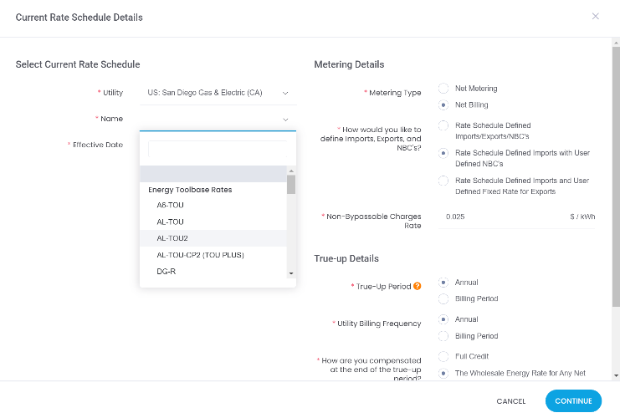
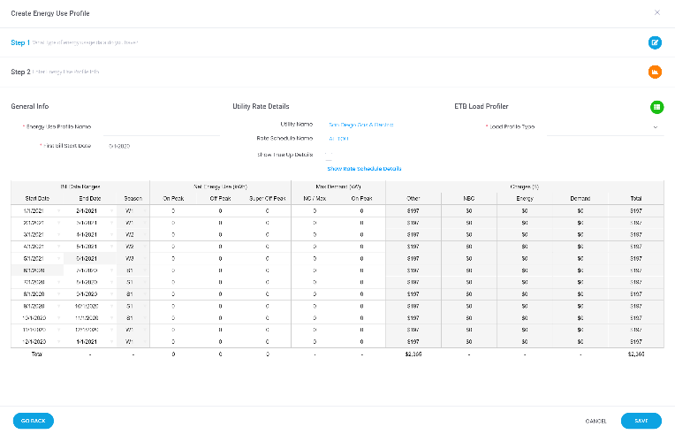
Create an Energy Use Profile
Under each meter, you can create an unlimited amount of Energy Use Profiles.
An Energy User profile is where you enter your customers Utility, Rate Schedule, and monthly energy and demand usage.
In step one of adding an Energy Use profile, you will select the type of data you will use: Monthly Bills, Interval Data, Green Button Data, or our UtilityAPI integration.
In Step two, you will set your customers' utility, rate schedule, and metering details.
If you selected monthly bills, you would enter your customers' kWh and kW usage. For all other types of data, the usage is applied automatically.
If the utility or rate schedule you are looking for is not listed in the dropdowns, please reach out to our Utility Rate's Team at utilityraterequest@energytoolbase.com to have them added.

Slide 5
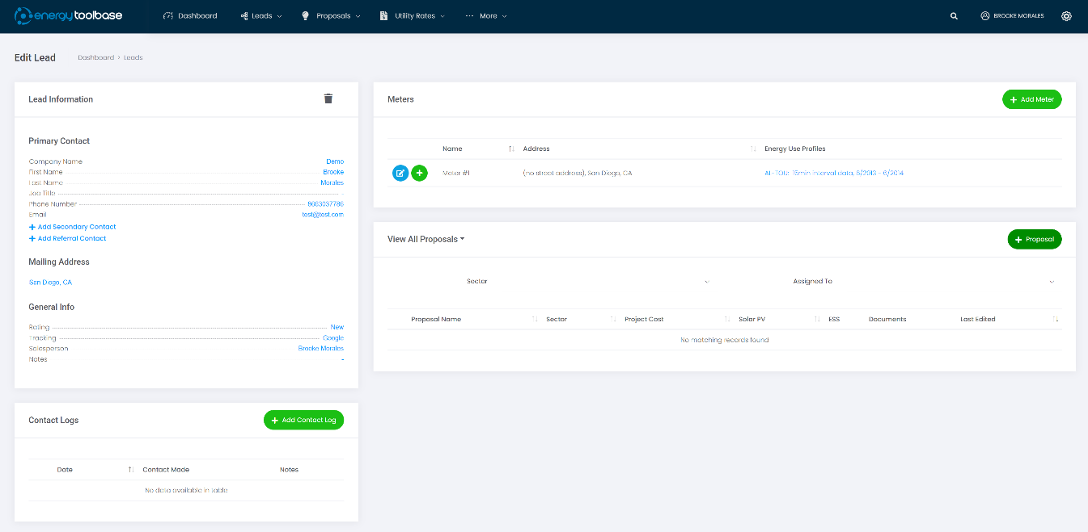
Create a Proposal
Once an Energy Use Profile is created, you’ll be brought back to the Edit Lead page
From this page, you can add a proposal.
Users can create an unlimited number of proposals within a lead.
Click to add a Proposal. Alternatively, you can create an Energy Use Profile first.
5

Slide 6
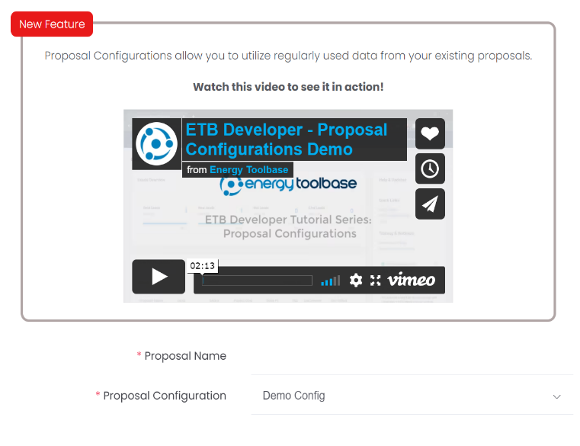
Proposal Configurations
After selecting the ‘Add Proposal’ button, you will be asked to give your proposal a name and select a Proposal Configuration.
ETB’s new Proposal Configuration feature allows you to use your existing proposals as templates to create new ones. You can easily apply all types of data like PV and ESS sizes, transactions and incentives, documents, and even rate switch information.
Every account is preloaded with an empty default configuration.
You can add a new configuration by opening an existing proposal and clicking the menu on the top right of the General Information portlet.
From there, you will select ‘Create New Proposal Configuration’, name the configuration, choose whether you would like to make it your default configuration, and save.
Now, when creating a new proposal, you will be able to select the proposal configuration you just made.
Note: Applying a proposal configuration to an existing proposal will overwrite the current proposal details.

Slide 7
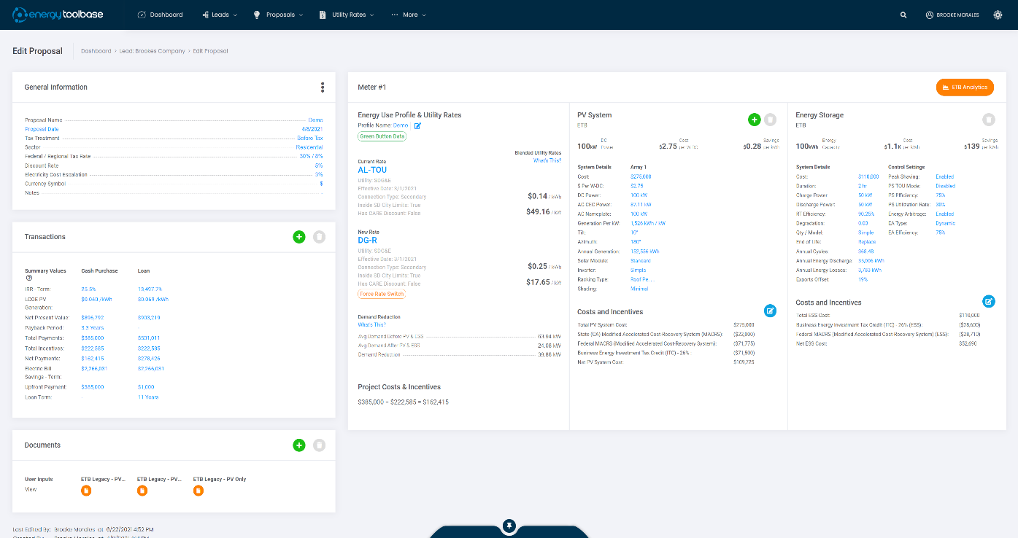
Proposal Editor
You’ll find the following sections
in our Proposal Editor …
ETB's proposal creation process has gone through a significant change with the v4 updates. What once was a 7-Step process that limited the ability to see any other data except the current step you are on; is now all viewable on a single page. We organized this page in a way where our users can swiftly analyze their proposal data, which makes building a proposal in ETB quicker than ever.
General Information
Meter Portlet
Transactions
Documents

Slide 8
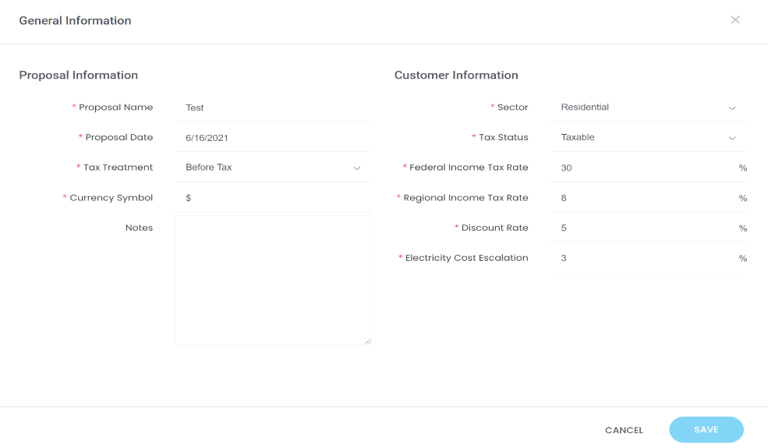
Proposal Editor: General Information
In the General Information section of the Proposal, you can specify details about the customers' sector, Tax Status, Federal and Region Tax Rate, etc. This is also where you can input the 'Electricity Cost Escalation' rate (be mindful of how you define this).You also can change the currency symbol of your proposal document to that of your customer.
8

Slide 9
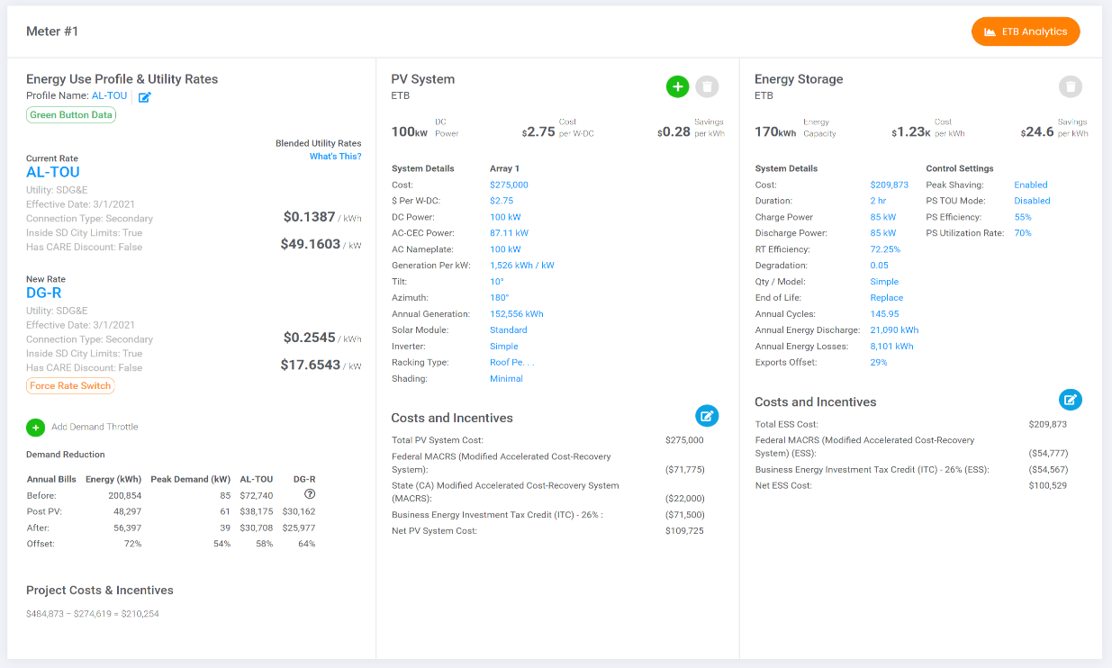
Proposal Editor: Meter Portlet
To the right of our Proposal Editor, you will find the meter portlet. The title of this portlet will be the Meter name you’ve applied on your lead.
For multi-meter projects, this title will become a dropdown to select the meters you want to apply in your proposal.
In the Meter Portlet, there are three sections:
Energy Use Profile & Utility Rates
PV System
ESS System
This is where the bulk of your proposal data will be applied. From utility rates to incentives.
On the top right of this portlet is where users can access ETB Analytics

Slide 10
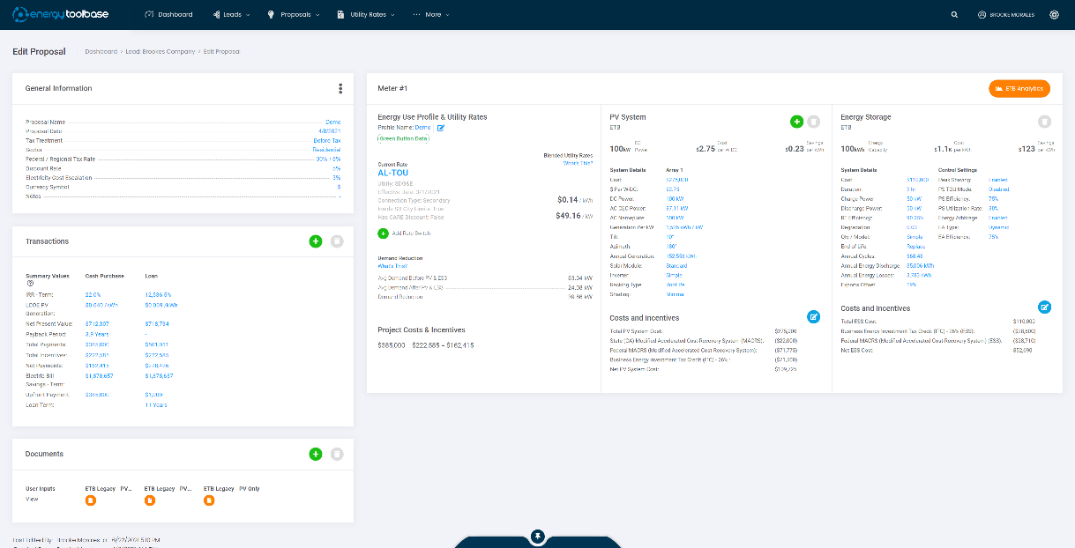
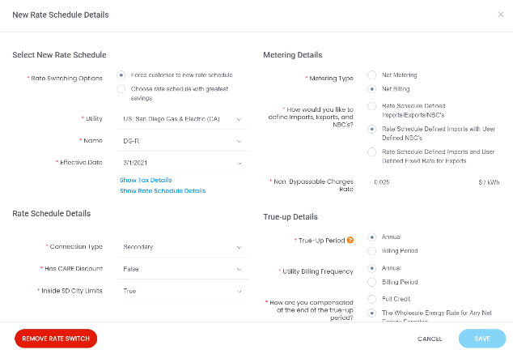
Meter Portlet: Energy Use Profile & Utility Rates
In the Energy Use Profile & Utility Rates section, you can select which Energy Use Profile you want applied to your analysis.
You can edit your Energy Use Profile from the proposal by clicking the edit icon next to the profile name.
To add a rate switch, click the ‘Add Rate Switch’ button and select a new rate.
Depending on the selection you made when applying your rate switch, you will see a tag below the rate that provides the ‘Greatest Saving’ or the ‘Forced Rate Switch.’

Slide 11
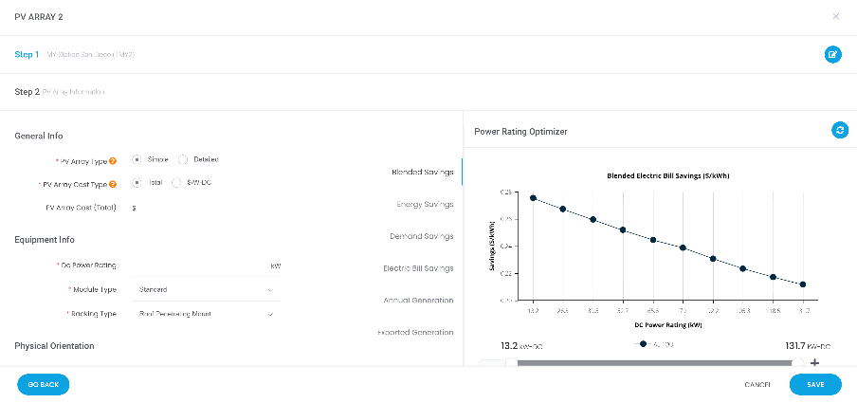
Meter Portlet: PV System
In this section, you can specify the details of your PV System. By pressing the green plus button across from 'PV System,' you can start the process of adding a PV array.
You will then select the type of Solar Generation Data you are using: PVWatts, HelioScope, or Spreadsheet Interval Data.
After selecting your data type, you will enter your PV Array Information. Here you can utilize the ETB Power Rating Optimizer to calculate and visualize the dollar savings, based on the user's specified proposal inputs, for (10) different sized systems.
Once you apply your PV System(s), the DC Power, Cost per W-DC, and Savings per kWh will be displayed at the top of the summary, with additional details shown below.
Under the 'Cost and Incentives' header, you will find the total system cost. This is also where you can add PV Incentives.

Slide 12
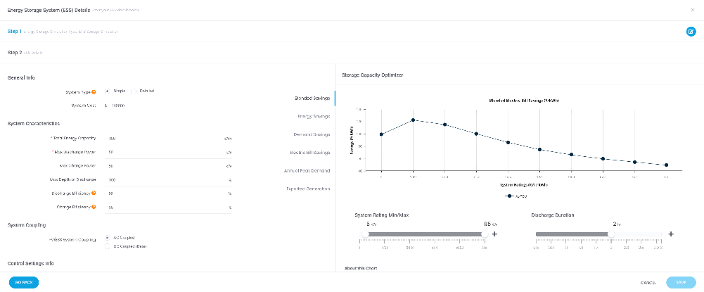
Meter Portlet: Energy Storage
In this section, you can specify the details of your Energy Storage System. By pressing the green plus button across from ‘Energy Storage,’ you can start the process of adding ESS.
You will then select how you want to simulate the performance of your ESS by selecting either an ETB Simulation, Interval Data, or by using one of our Integrated Partners.
Going through the ETB Simulation will bring you to Step 2, where you will enter your ESS Details. Here you can utilize ETB’s Storage Capacity Optimizer. The results shown in the optimizer are affected by the values entered in the ESS details listed on the left, and each charge will represent a default of 1 to 10 systems.
Once an Energy Storage System has been applied, the Energy Capacity, Cost per kWh, and Savings per kWh will be displayed at the top of the summary, with additional details shown below.
Under the ‘Cost and Incentives’ header, you will find the total system cost. This is also where you can add ESS Incentives.

Slide 13
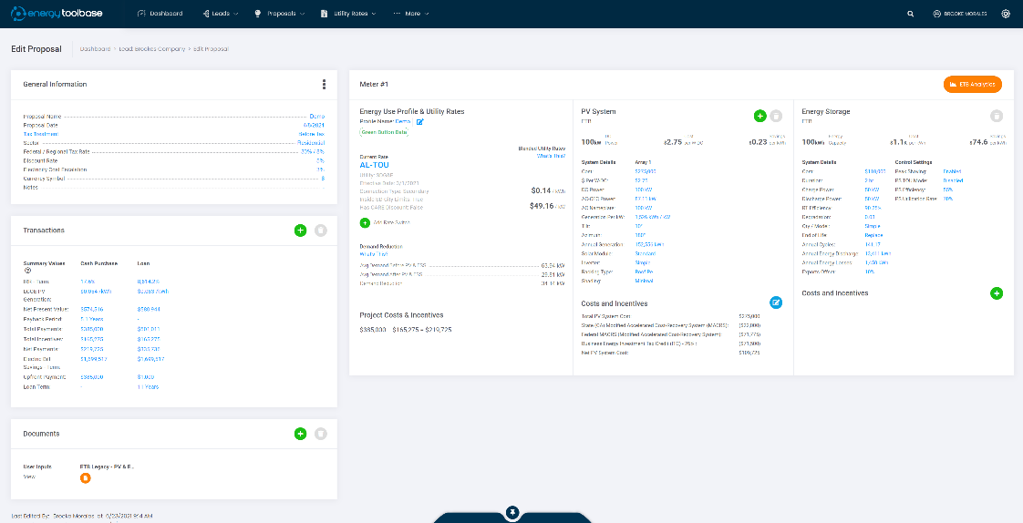
Proposal Editor: Transactions
The Transaction portlet of the Proposal Editor is where you can specify which Financing Transaction to include in your proposal.
Clicking the 'Add Transaction' button will display a list of various transaction types in a list.
Depending on which Transaction you select and how that Transaction Template is set up, you may be required to specify specific transaction inputs. All transaction inputs are customizable and can be pre-specified in the company setting.
You can add multiple transactions to your proposal.

Slide 14
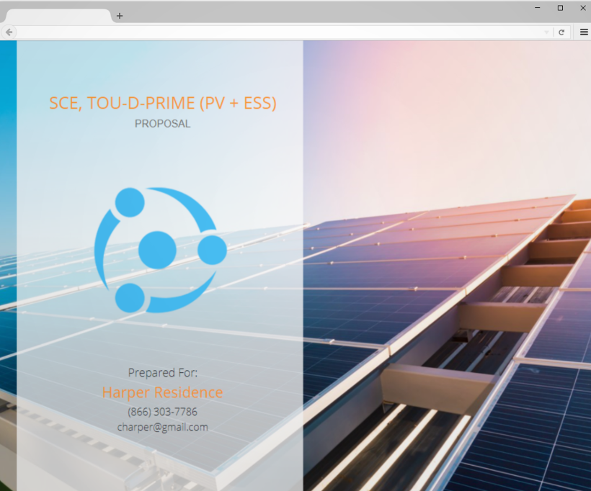
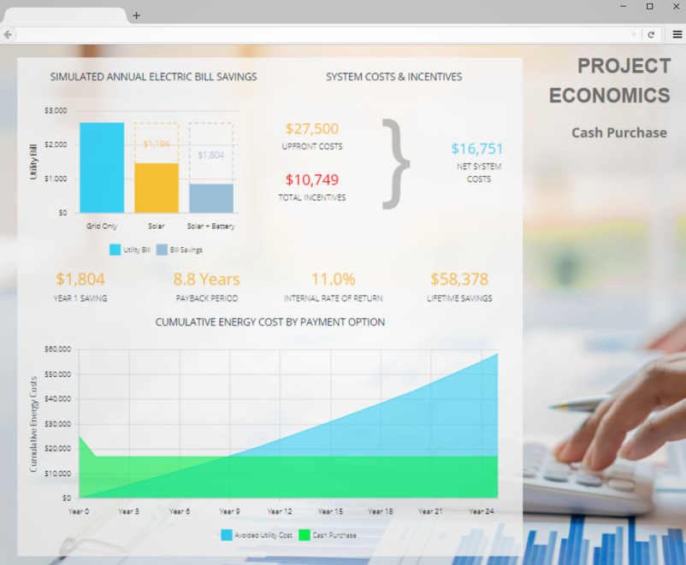
Proposal Editor: Documents
The documents section of the Proposal Editor is where you can add the documents you want to generate for a given proposal. Clicking the ‘Add Document’ button will bring you to a list of all of your documents.
Authorized Users can edit or create Document templates. ETB also provides a multitude of standard template options.
Depending on which document (s) you select and how that Document Template was set up, you may be required to specify additional user inputs. These document user inputs are customizable and can be managed from the ‘Document Template’ screen.
After selecting a document from the list, it will be shown in the document portlet in the proposal editor.
Click on the “View” button to view the generated document. You can then present it to a customer directly with Energy Toolbase via computer or tablet, or the document can be exported to PDF to print or email.

Slide 15
For assistance, please reach out
866-303-7786
www.energytoolbase.com

